Slide 1


NyayaMithra: A Generative AI-Based Legal Assistance System for Indian Citizens
CSA6502- Generative AI for and Large Language Models
Supervisor:
Dr. NITHISHA J
Presented By:
C. Anu Keerthana – 192472057
S. Sirivally- 192472371
M. Madhulika-192472188

Slide 2
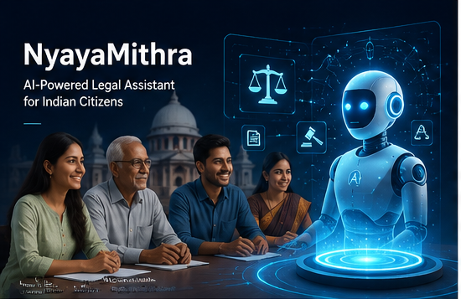
INTRODUCTION
Access to legal information is difficult for many Indian citizens due to complex legal language and high consultation costs.
Most legal resources are available on government portals, making them difficult for common people to understand.
Citizens often face challenges in understanding legal procedures, documents, and complaint filing.
NyayaMithra is a Generative AI-based legal assistant that provides simple and reliable legal guidance.
It uses Retrieval-Augmented Generation (RAG) to retrieve information from official Indian legal documents and generate accurate.

Slide 3
PROBLEM STATEMENT
Many Indian citizens lack awareness of their legal rights and procedures.
Legal information is often written in complex language, making it difficult for non-lawyers to understand.
Hiring legal professionals can be expensive and time-consuming.
Understanding legal documents and preparing complaints or applications is challenging for common citizens.
There is a need for an AI-powered legal assistant that provides simple, reliable, and accessible legal guidance using official legal sources.

Slide 4

OBJECTIVES
Simplify Indian legal information into easy-to-understand language.
Answer legal questions using official legal documents.
Analyze and summarize legal documents.
Generate legal complaint and application drafts.
Support multilingual interaction.
Improve legal awareness using Generative AI.

Slide 5
Literature Review
Author Name | Year | Title of Paper | Journal/Conference | Methodology | Limitations
Bommarito II, M. & Katz, D. | 2024 | GPT-4 Passes the Bar Exam: Artificial Intelligence and Legal Reasoning | Artificial Intelligence & Law | GPT-4, Large Language Models (LLMs) | May generate hallucinated legal information without external knowledge.
Lewis et al. | 2022 | Retrieval-Augmented Generation for Knowledge-Intensive NLP Tasks | NeurIPS | Retrieval-Augmented Generation (RAG), Dense Retrieval | Performance depends on the quality of the retrieved documents.
Xiao Liu et al. | 2023 | ChatLaw: Open-Source Legal Large Language Model | arXiv | LLM Fine-Tuning, Legal QA, Prompt Engineering | Primarily trained on Chinese legal datasets, limiting direct applicability to Indian law.
Jiang et al. | 2024 | Large Language Models for Legal Intelligence: A Survey | ACM Computing Surveys | LLMs, RAG, Prompt Engineering | Highlights concerns regarding bias, explainability, and legal reliability.
Zheng et al. | 2025 | LegalRAG: Retrieval-Augmented Generation for Legal Document Understanding | IEEE Access | RAG, Vector Database, Semantic Search | Requires updated legal knowledge bases for accurate responses.

Slide 6
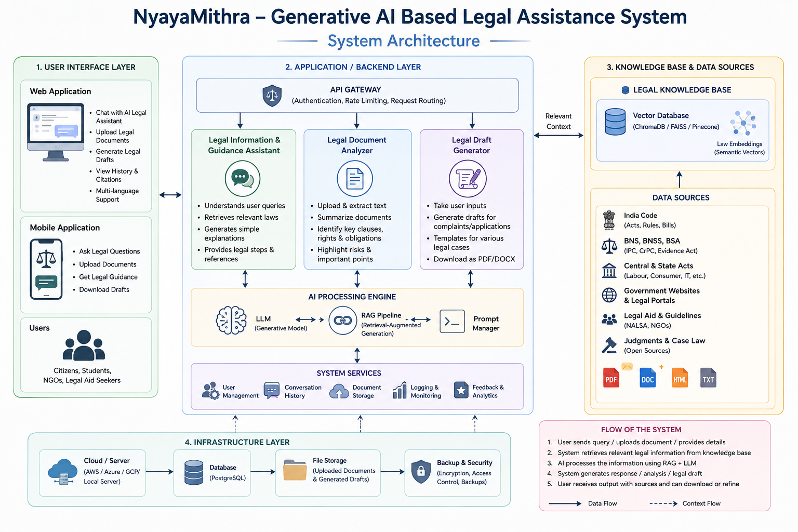
SYSTEM ARCHITECTURE

Slide 7
Module 1: AI Legal Advisor & Rights Navigator
What it does:
Provides legal guidance by explaining Indian laws, citizen rights, and legal procedures in simple language.
Techniques used:
RAG, Large Language Model (LLM), NLP, Semantic Search, Prompt Engineering.
Components used:
India Code, BNS, BNSS, BSA, Vector Database, Embedding Model, LLM API, FastAPI.
How it works:
User asks a legal question.
Relevant legal sections are retrieved.
AI generates a simple explanation.
Legal references are displayed.
User receives guidance with citations.

Slide 8
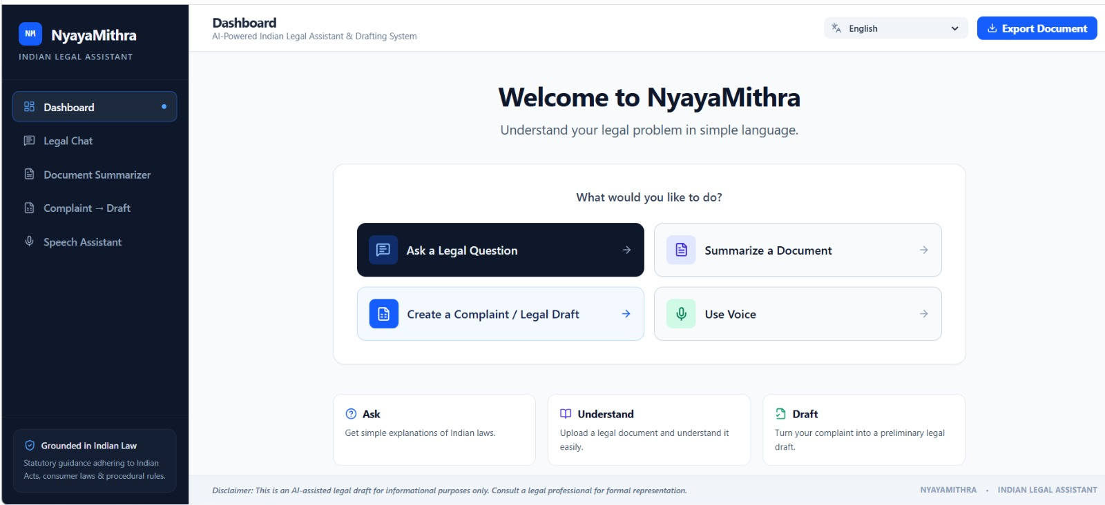
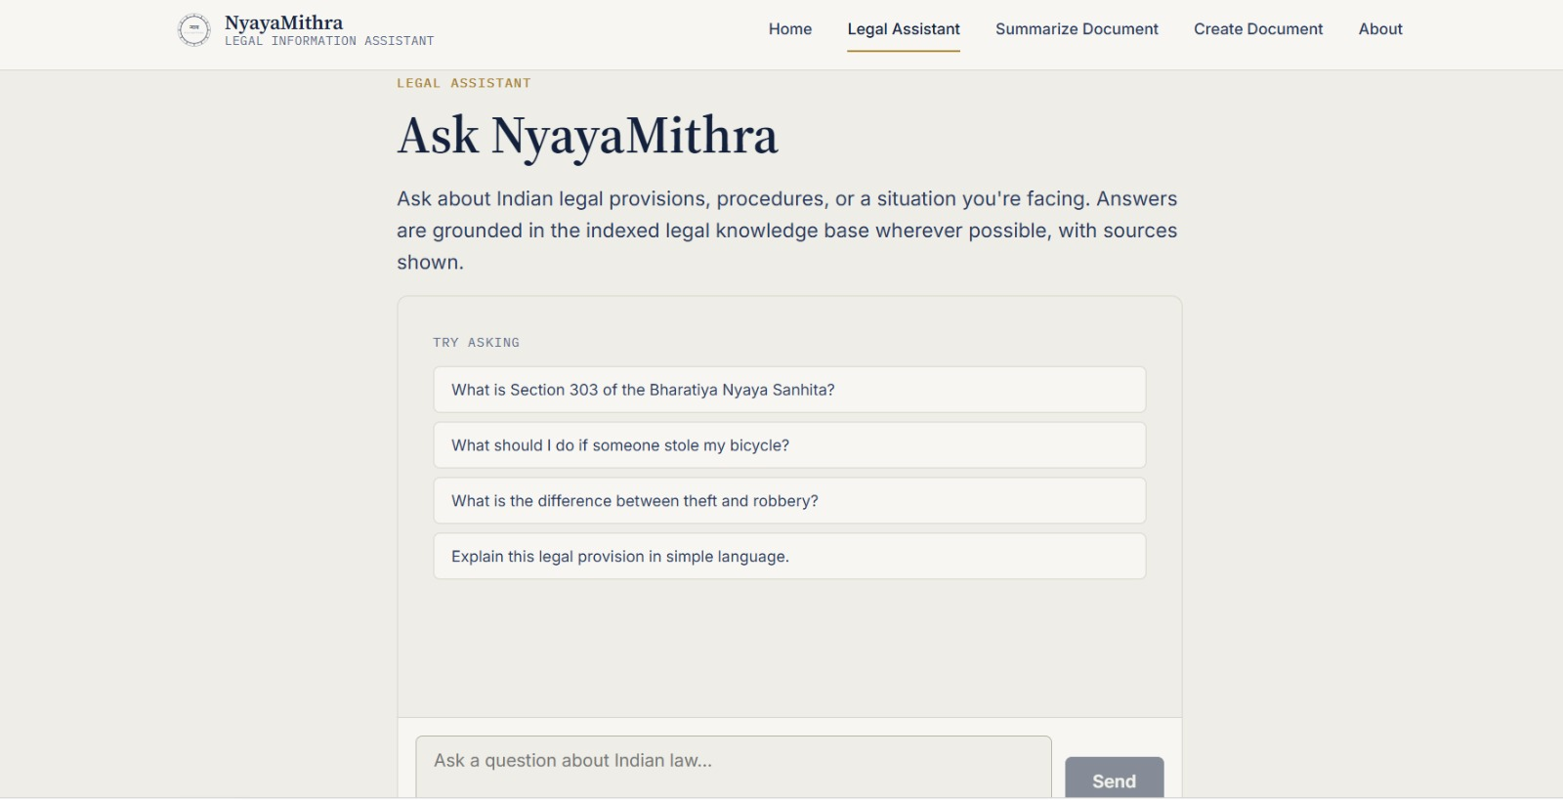
Module 1:Implementation

Slide 9
Module 2: Smart Legal Document Intelligence
What it does:
Analyzes legal documents, summarizes content, and explains important clauses in simple language.
Techniques used:
Document Parsing, Text Summarization, RAG, NLP, OCR (Optional).
Components used:
PDF Upload, PyMuPDF, Embedding Model, Vector Database, LLM, FastAPI.
How it works:
User uploads a legal document.
Text is extracted and processed.
AI summarizes the document.
Important clauses and risks are identified.
Simplified results are displayed.

Slide 10
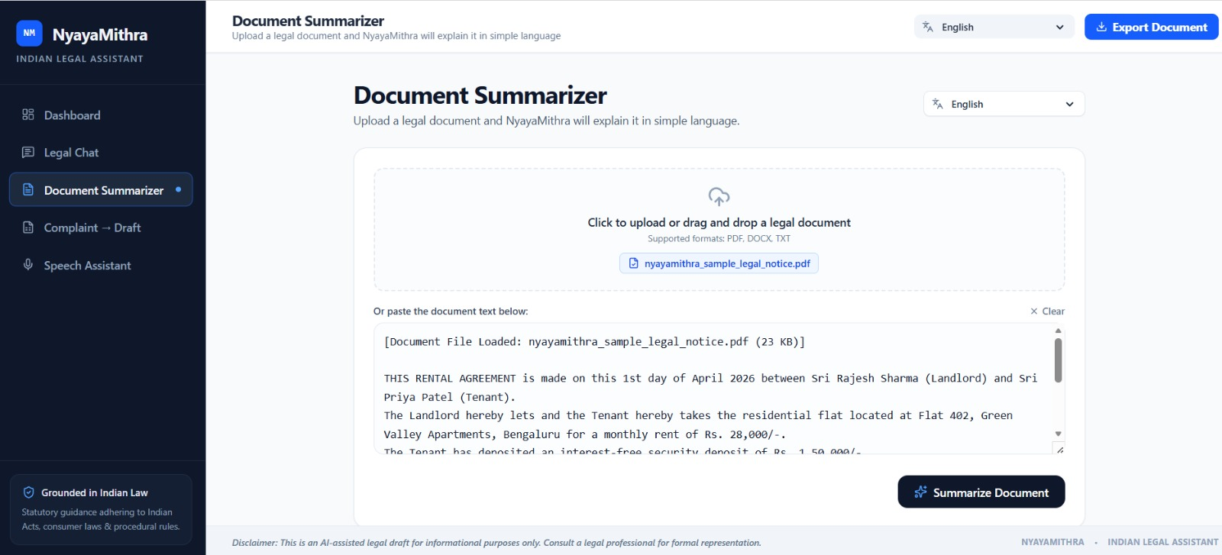
Module 2:Implementation

Slide 11
Module 3: AI Legal Action & Draft Assistant
What it does:
Generates legal complaint and application drafts based on user-provided information.
Techniques used:
Prompt Engineering, LLM, Natural Language Generation (NLG), Template-Based Generation.
Components used:
Draft Templates, User Forms, LLM API, Document Generator (PDF/DOCX), FastAPI.
How it works:
User selects a document type.
Required details are entered.
AI generates the legal draft.
User reviews the draft.
Document is downloaded or edited.

Slide 12
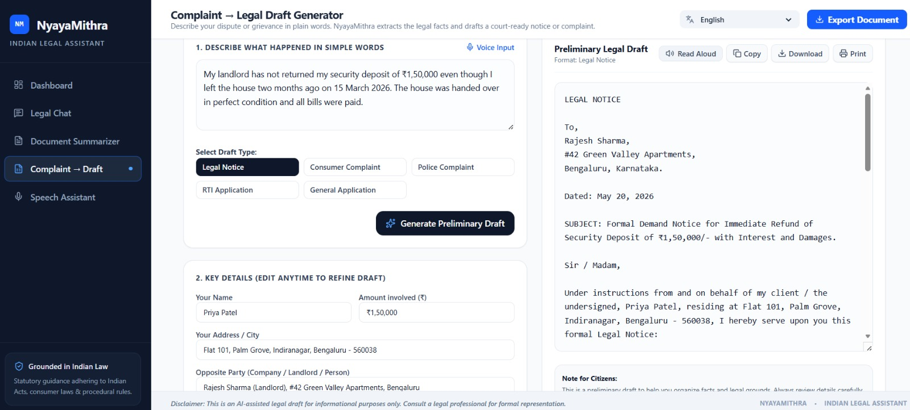
Module 3:Implementation

Slide 13
Future Enhancements
Multilingual Support – Extend assistance to major Indian regional languages.
Voice-Based Legal Assistance – Enable users to ask legal queries using voice.
Real-Time Legal Updates – Integrate updated Indian laws, acts, and court judgments.
Personalized Legal Guidance – Provide responses based on the user's specific case details.
Legal Document Automation – Automatically generate petitions, applications, notices, and complaints.
Court & Case Tracking – Provide case-status and hearing-date information through integration with official sources.
Advanced RAG System – Improve accuracy by retrieving information from verified legal databases.
Mobile Application – Develop an Android/iOS app for easier access to legal assistance.

Slide 14
Challenges Faced
Legal Data Availability – Collecting reliable and updated Indian legal documents.
Accuracy of Responses – Generative AI may sometimes produce incorrect or misleading information.
Complex Legal Language – Converting complicated legal terminology into simple language.
Multilingual Complexity – Maintaining accuracy across different Indian languages.
Data Privacy – Protecting sensitive personal and legal information provided by users.
Hallucination Risk – AI may generate information that is not supported by legal sources.
Frequent Law Changes – Keeping the knowledge base updated with amendments and new judgments.
Legal Responsibility – Ensuring the system provides assistance without replacing professional legal advice.

Slide 15
CONCLUSION
NyayaMithra leverages Generative AI and Retrieval-Augmented Generation (RAG) to make legal information simple, accessible, and reliable for Indian citizens.
The system provides legal guidance, document analysis, and legal draft generation using official legal sources.
It promotes legal awareness, reduces the complexity of legal procedures, and improves access to legal information.
The platform is designed as an informational and educational assistant, supporting—not replacing—professional legal services.
Future enhancements include voice support, regional language expansion, real-time legal updates, and integration with government legal portals.

Slide 16


